Slide 1
Dear Teacher…
Thank you for using this resource. We hope it helps you, and your pupils! This advice may help.
PowerPoints cover more than one lesson
The PowerPoint presentation matches a section in the planning provided for this unit of work. This is likely to contain material for more than one lesson. It is important not to speed through the slides without completing suggested activities or discussion. Most sections in the planning, and the matching PowerPoints, will cover two lessons. In particular, you may wish to spend one lesson looking carefully at a story/ video clip and its meaning, and another with discussion, acting it out and follow up.
Please make sure you prepare and plan with staff
It is critical that delivery, style and speed to reflect the needs and responses of pupils. The resource has been designed to support teachers, not to replace you! If this resource is provided as supporting material for HLTAs, cover teachers or non-specialists please ensure you prepare them carefully and plan with them.
We recommend you use the detailed planning as well as this PowerPoint
This PowerPoint is designed to be used with the detailed planning written to support the RE syllabus ‘Believing and Belonging’. We strongly recommend that you use the PowerPoint in conjunction with the planning. Please ask us how to access this if you do not have it.
To feed back and for further support and to access webinar training please email enquiries@penninelearning.com.

Slide 2

Notes for teachers
Where this lesson fits: This lesson provides an opportunity to revisit the story of Moses and the Exodus, focusing on the freedom from slavery and God’s protection, following the Hebrews’ Exodus from Egypt. After discussing the journey of the Hebrew people in the desert, pupils will reflect on the idea of being on a journey. They will then go on to learn more about the festival of Sukkot, building on prior learning, with a focus on how God protected the Hebrews. As well as this, they will look at the festival of Simchat Torah. Pupils will then have a go at designing their own sukkah (a temporary shelter or hut).
Points to watch: Please note that Jewish people do not use the full name for God and would prefer it written as G_d. Jews believe that his name is holy and feel it would be an insult if the paper with his name on were torn or dropped. In this unit we will write God in full, but remember to point this out to pupils and if you do have Jewish children in your class they might prefer to write it as G_d.
Enrichment ideas: This lesson will be enriched by an opportunity to interview a Jewish person about the importance of the Torah to them.
Further lesson notes and additional ideas may be found in the notes section of some slides. Please refer to the full unit plan for more activities and resources.
Notes:
Previous learning: The story of Moses is included in LKS2 unit CL2.6 and UKS2 unit CU2.6.
Please refer to the full unit plan for more activities and resources.
Please note that individual slides may have additional notes added in the ‘Notes’ section.

Slide 3
Notes for teachers
Slide 15 and 16: Suggested video. Watch the first part of the clip to see how Sukkot is celebrated today:
https://www.chabad.org/library/article_cdo/aid/4457/jewish/How-To-Celebrate-Sukkot.htm
Slide 21: Suggested mind map activity (see the following slide 20 for an idea). Pupils can be given a picture of the Procession of the Law to stick in the middle of their mind map. Link for the activity: https://jewishmuseum.org.uk/schools/asset/procession-of-the-law/
Notes:
Previous learning: The story of Moses is included in LKS2 unit CL2.6 and UKS2 unit CU2.6.
Please refer to the full unit plan for more activities and resources.
Please note that individual slides may have additional notes added in the ‘Notes’ section.

Slide 4
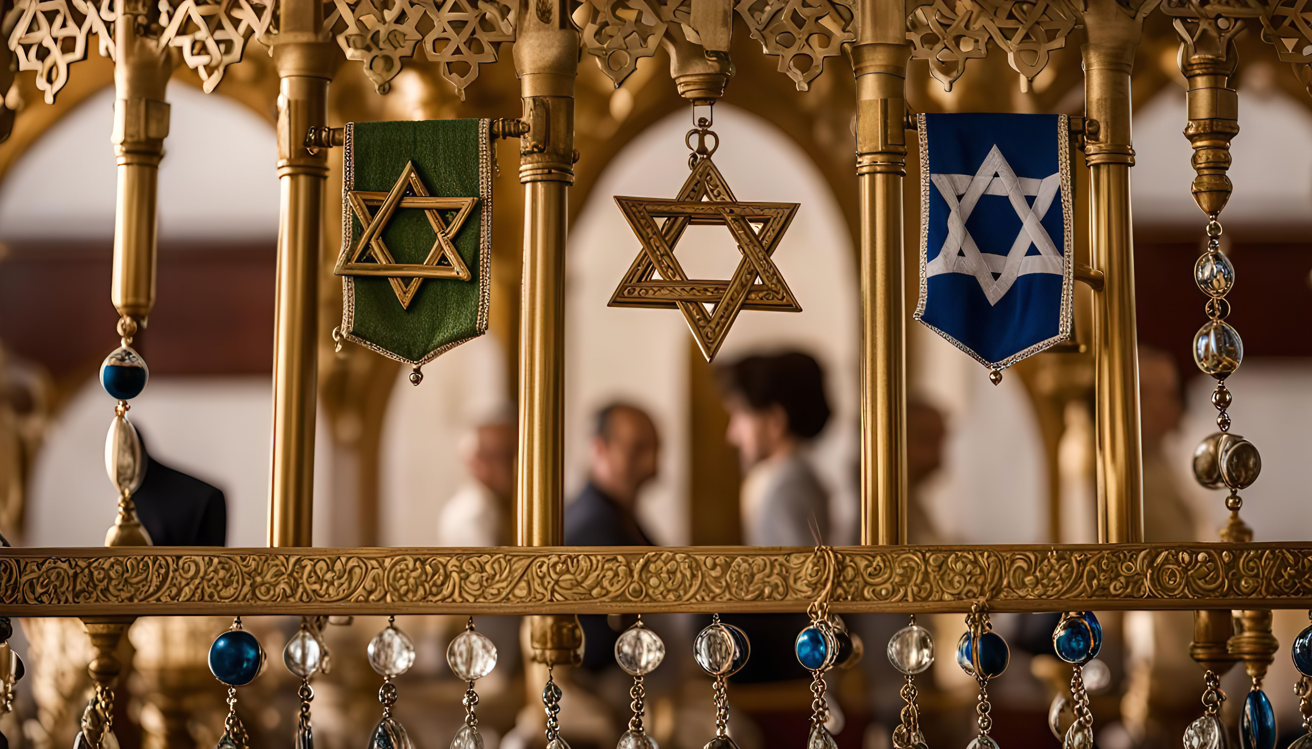

How does the festival of Sukkot remind Jewish people of their ancestors’ journey in the desert?
Unit: CU2.5
How and why are Jewish festivals celebrated today?
Presentation 3

Slide 5

Pathway 5: Influence and Authority
Key Stage 2
Through studying Influence and Authority, pupils should learn that:
Communities worldwide are shaped by traditional beliefs from religions/worldviews.
Some are influenced by a single source and others by many.
In some communities, the influence of a religion/worldview is largely limited to its followers.
This presentation will focus on festival of Sukkot and how it reminds Jewish people of their ancestors’ journey in the desert. You will learn how it is celebrated today thinking of the things that stay the same or change.

Slide 6
Learning objectives
Summarise the celebration of Sukkot and explain how it acts as a reminder
Make connections between ancient stories and modern celebrations

Slide 7
Key words
Hebrew
A member of an ancient people that were ancestors of the Jewish people
Exodus
The liberation of the Hebrew slaves from Egypt
Simchat Torah
The Jewish festival that celebrates the conclusion of the annual cycle of Torah readings and the beginning of a new cycle

Slide 8
Introduction: What do we already know about Moses?
Arrange these events from the story of Moses into chronological order.
After God unleashed ten plagues on the Egyptians, Moses led the Hebrew people out of Egypt, across the Red Sea.
Moses was raised as a prince, by the Pharaoh’s daughter.
Moses was born in Egypt to a Hebrew family, who were slaves.
Moses returned to Egypt and asked the Pharaoh to free his people.
Moses heard the voice of God from a burning bush and God asked Moses to return to Egypt and free the slaves from captivity.
After killing an Egyptian guard, Moses fled to another land and worked as a shepherd.

Slide 9
Introduction: What do we already know about Moses?
Check your answers
1. Moses was born in Egypt to a Hebrew family, who were slaves.
4. Moses heard the voice of God from a burning bush and God asked Moses to return to Egypt and free the slaves from captivity.
2. Moses was raised as a prince, by the Pharaoh’s daughter.
5. Moses returned to Egypt and asked the Pharaoh to free his people.
3. After killing an Egyptian guard, Moses fled to another land and worked as a shepherd.
6. After God unleashed ten plagues on the Egyptians, Moses led the Hebrew people out of Egypt, across the Red Sea.

Slide 10
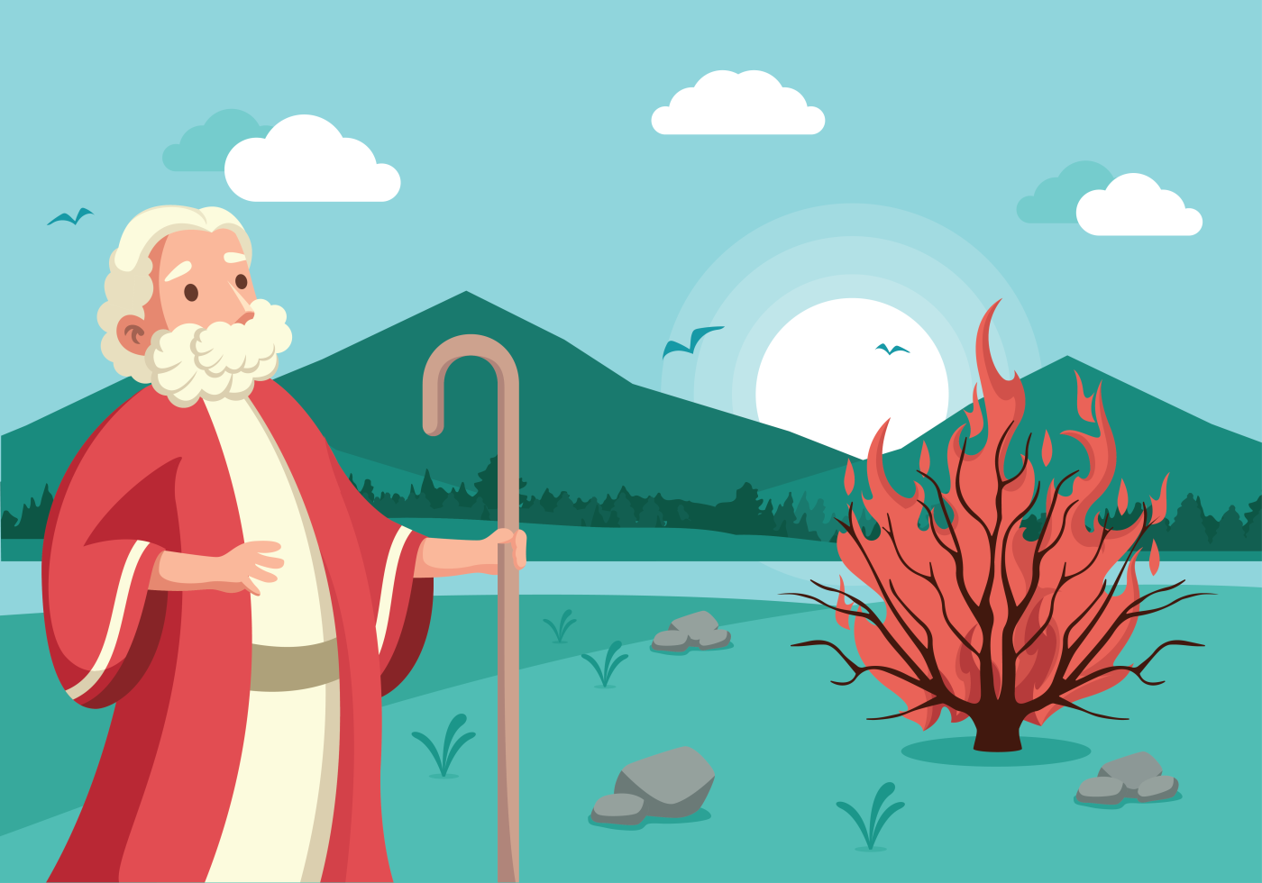
Moses and the Exodus: Freedom from slavery
Moses was born to a Hebrew family but he was raised by the Pharaoh’s daughter and grew up as an Egyptian prince.
After killing an Egyptian guard, who was beating a Hebrew slave, Moses fled to a neighbouring land.
After God spoke to him from a burning bush, Moses returned to Egypt to ask the Pharaoh to free the Hebrews from slavery.
After the final plague, the Pharaoh agreed. However, he soon changed his mind.
Moses led the the Hebrew slaves out of Egypt, through the Red Sea.
Notes:
This part of the story of Moses and the Exodus should be viewed as revision, as pupils should have covered this story in detail in KS1.
Pupils can be reminded that the festival of Pesach, which they covered in Lesson 1, commemorates the exodus of the Hebrew people from slavery in Egypt.
Sukkot commemorates God’s divine protection of the Hebrew people, after their departure from Egypt, when they wandered the desert for 40 years.

Slide 11
Moses and the Exodus: Gods protection
The story of Moses and the Exodus is a key story for Jewish people, as it represents freedom from slavery and God’s protection as they wandered in the desert.
The festival of Sukkot, which we will be learning about in this lesson, commemorates God’s protection of the Hebrew people, after their departure from Egypt, when they wandered in the wilderness for 40 years.
Notes:
Pupils can be reminded that the festival of Pesach, which they covered in Lesson 1, commemorates the exodus of the Hebrew people from slavery in Egypt.
Sukkot commemorates God’s divine protection of the Hebrew people, after their departure from Egypt, when they wandered the desert for 40 years.

Slide 12
Moses and the Exodus: The Journey to the Promised Land
After they fled Egypt and crossed the Red Sea, the Hebrews were finally free. However, their journey to the promised land was full of challenges.
The Hebrews were hungry and thirsty. Moses told them that God would provide for them.
God sent a special bread-like substance (manna), as well as a flock of quails, which the Hebrews could eat.
God also told Moses to strike a rock with his staff to produce water.

Slide 13
Summary: The Journey to the Promised Land
Can you remember three of the ways in which God provided for the Hebrews in the wilderness?
Share it with a partner.
1.
2.
3.

Slide 14
Discussion
Think about the idea of being on a journey away from home:
What essentials would you need?
What home comforts would you miss?
Think about the ‘in-between’ stage of the journey of Moses and his people: they had escaped from slavery but were not yet in the promised land. Shelter was temporary – in tents – and they relied on manna provided by God each day.
How do you think the Hebrew people felt?
What would you find most challenging in a situation like this?

Slide 15
The festival of Sukkot
The festival of Sukkot is a harvest festival soon after the Jewish New Year, in which people give thanks for food and shelter. It lasts for seven days.
The festival is a time to give thanks for a successful harvest. As well as this, Sukkot is a time when Jewish people remember the period after the Exodus, when Moses led the Hebrew people out of slavery. It commemorates the 40 years the Hebrew people spent in the desert, on their way to the promised land, once they had escaped slavery.
It is a time when Jewish people remember Gods protection of their ancestors in the harsh conditions of the desert and how he provided for them during the 40 years they spent wandering in the desert.
Notes:
Watch the first part of this clip to see how Sukkot is celebrated today:
https://www.chabad.org/library/article_cdo/aid/4457/jewish/How-To-Celebrate-Sukkot.htm

Slide 16

How is Sukkot celebrated today?
Many people celebrate by building a sukkah – a temporary hut or shelter. Families will then spend time in these huts for a week. This is to remind themselves of the conditions Moses and his people lived in during the 40 years they wandered the desert, after the Exodus.
Building and living in these huts is therefore a way for Jewish people to honour their ancestors. Spending time in a sukkah allows Jewish people to appreciate Gods protection. Staying in a fragile hut is a reminder that God is the only source of security and protection.
Notes:
Watch the first part of this clip to see how Sukkot is celebrated today:
https://www.chabad.org/library/article_cdo/aid/4457/jewish/How-To-Celebrate-Sukkot.htm
This Photo by Unknown Author is licensed under CC BY-ND

Slide 17
Moses and the Exodus: The journey to the promised land
After a few months of travelling, Moses brought the Hebrews to Mount Sinai, where he heard the voice of God again.
On the mountain, God gave Moses the ten laws known as the Ten Commandments, which were rules telling people how to live.
Moses led the Hebrews in the Sinai wilderness for 40 years, before they eventually entered the promised land.

Slide 18
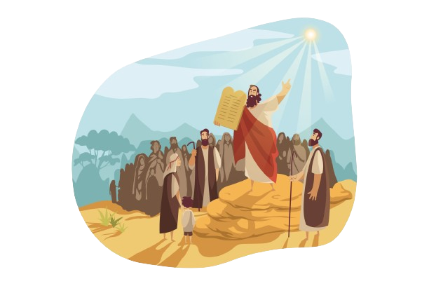
The Ten Commandments
Here is a reminder of the Ten Commandments:
Do not have any other Gods.
Do not make idols.
Do not disrespect God’s name or use it in vain.
Keep the Sabbath day holy.
Honour your father and your mother.
Do not commit murder.
Do not commit adultery.
Do not steal.
Do not tell lies or bear false witness.
Do not be envious of others.
The Torah contains the Ten Commandments. The word Torah itself means ‘instruction’.

Slide 19
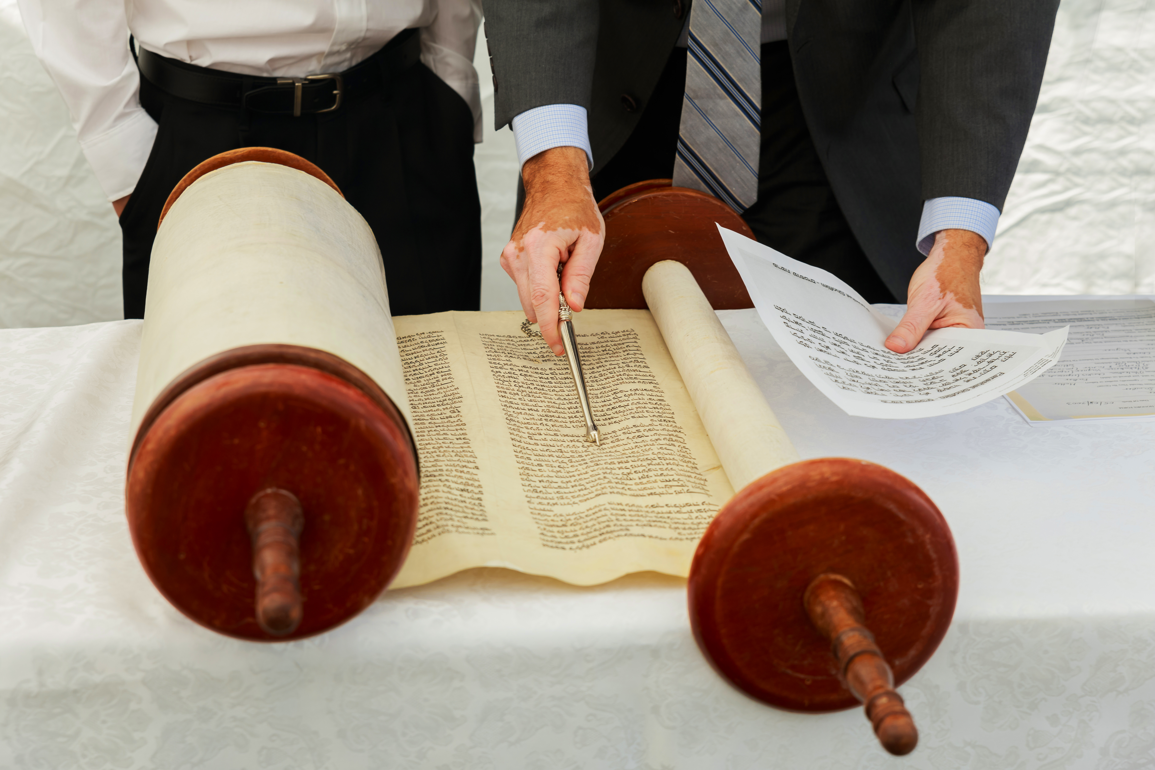
Simchat Torah
At the end of the festival of Sukkot, the celebration of Simchat Torah takes place.
This day completes the annual Torah reading - and then it immediately begins again. All the Torah scrolls are held aloft and processed around the synagogue seven times.
This is followed by dancing, candle lighting and celebration meals.
The Torah refers to the Five Books of Moses: Genesis, Exodus, Leviticus, Numbers and Deuteronomy.
Notes:
This Photo by Unknown Author is licensed under CC BY-SA

Slide 20
Task: Design a sukkah
Look at images of sukkahs created and used by Jewish families during the festival of Sukkot - they provide shade but have gaps in the natural roof to look at the stars.
Have a go at designing (and perhaps making) a Sukkah for the class.
Think carefully about the features of a sukkah:
It must have a minimum of three walls.
Its roof must be made from something natural.
It should be decorated with things from the harvest.
Notes:
Two tasks are provided in this PowerPoint, to cover both Sukkot and Simchat Torah.
This PowerPoint/topic could therefore be delivered over two lessons.
Other activities:
Interview a Jewish person about the importance of the Torah to them. Choose questions carefully. Or Watch clip 09 'The Torah' here https://www.penninelearning.com/videos/
Please refer to the full unit plan for more activities and resources.

Slide 21
Task: Procession of the Law
Look at the painting ‘Procession of the Law’ from the Jewish Museum in London, depicting Simchat Torah in the 19th Century.
What do you notice?
How can you link the details in the picture to what you have learned about Simchat Torah?
Have a go at answering the following questions:
What can you see?
What do you know?
What do you wonder?
Notes:
This activity could be completed as a mind map activity (see the next slide for an idea). Pupils can be given a picture of the Procession of the Law to stick in the middle of their mind map. Link for the activity: https://jewishmuseum.org.uk/schools/asset/procession-of-the-law/
Encourage pupils to think about the following things:
What can you see?
Details of Torah scrolls, candles and prayer shawls. How many Torah scrolls can the children spot? How are the shawls being worn? How many types of candle holders are there?
What do you know?
Encourage children to make links between what they can see with what they know about Simchat Torah and other aspects of Judaism, focusing on the great respect Jewish people have for the Torah.
Why are there so many Torah scrolls?
Why might the Torahs be wrapped in cloaks?
Why are the Torahs so beautifully decorated?
What do you wonder?
What do the children want to know when looking at the painting?
Link for the activity:
https://jewishmuseum.org.uk/schools/asset/procession-of-the-law/
Explore the information under the 3 sections on the above link when discussing the children’s answers:
What can we see?
What do we know?
What do we wonder?
Two tasks are provided in this PowerPoint, to cover both Sukkot and Simchat Torah.
This PowerPoint/topic could therefore be delivered over two lessons.
Other activities:
Interview a Jewish person about the importance of the Torah to them. Choose questions carefully. Or Watch clip 09 'The Torah' here https://www.penninelearning.com/videos/
Please refer to the full unit plan for more activities and resources.

Slide 22
Task: Procession of the Law
What can you see?
What do you know?
Procession of the Law
What do you wonder?
Notes:
This activity could be completed as a mind map activity.
Pupils can be given a picture of the Procession of the Law to stick in the middle of their mind map.

Slide 23
Learning summary
The story of Moses and the Exodus is a key story for Jewish people, as it represents freedom from slavery and God’s protection.
The festival of Sukkot is a time when Jewish people remember the period after the Exodus from Egypt and give thanks for a successful harvest.
The celebration of Simchat Torah takes place at the end of Sukkot to mark the completion of the annual reading of the Torah.

Slide 24
Quiz
Sukkot is a celebration of ______
The New Year
The harvest and the period after the Exodus from Egypt.
The creation of the world.
A miracle that occurred in the Temple of Jerusalem.

Slide 25
Quiz
Sukkot is a celebration of ______
The New Year
The harvest and the period after the Exodus from Egypt.
The creation of the world.
A miracle that occurred in the Temple of Jerusalem.

Slide 26
Quiz
2. Moses and his people wandered the desert for ______________.
40 years
One year
100 days
Seven days

Slide 27
Quiz
2. Moses and his people wandered the desert for ______________.
40 years
One year
100 days
Seven days

Slide 28
Quiz
3. How long is the festival of Sukkot?
Two days
Five days
Seven days
Ten days

Slide 29
Quiz
3. How long is the festival of Sukkot?
Two days
Five days
Seven days
Ten days

Slide 30
Quiz
4. A sukkah is a __________________
Special plate
Candle
Ram’s horn
Temporary hut

Slide 31
Quiz
4. A sukkah is a __________________
Special plate
Candle
Ram’s horn
Temporary hut

Slide 32
Quiz
5. Simchat Torah celebrates ________________
Buying a new Torah
The conclusion and beginning of the annual Torah-reading cycle
Reading from a new Torah
The day the Torah was received

Slide 33
Quiz
5. Simchat Torah celebrates ________________
Buying a new Torah
The conclusion and beginning of the annual Torah-reading cycle
Reading from a new Torah
The day the Torah was received

Slide 34
Quiz
6. When does Simchat Torah take place?
On the third day of Sukkot.
During the month of Tishrei.
At the beginning of Sukkot.
At the end of Sukkot.

Slide 35
Quiz
6. When does Simchat Torah take place?
On the third day of Sukkot.
During the month of Tishrei.
At the beginning of Sukkot.
At the end of Sukkot.

Slide 36
Pause for Thought
We have learnt about the festival of Sukkot and how it’s celebrated today to commemorate the period after Exodus and to remember Gods protection during this time.
Can you think of a time when someone has protected you or when you have felt protected?

Slide 37
Acknowledgements
Pictures licensed under Vecteezy.

