Slide 1



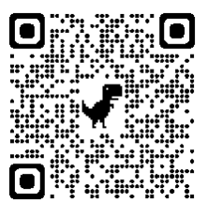

Unit 3.1: What is religion?
Key Questions
What is meant by religion and worldviews?
Why is there diversity within belief?
How do worldviews change?
Why do some worldviews change less?
What differences are there in non-religious worldviews?
How do worldviews impact our reality?
Prior Knowledge
Key terms
Institutional Worldview | A worldview held by a group to promote a certain way of life.
Personal Worldview | A person’s way of understanding, experiencing and responding to the world.
Agnosticism | A person who believes that you can’t be sure if God exists.
Atheism | A person who disbelieves or lacks belief in the existence a god or gods.
Antitheism | The belief that there is no God and that others should not believe either.
Lenses | The disciplines we use to evaluate things.
Theism | The belief in a god or gods.
Key information
46.2% of the UK described themselves as Christian.
37.2% of the UK described themselves as non-religious.
Since 2011, the Hindu, Sikh, and Jewish populations have stayed broadly the same.
There has been an increase in other religious groups including Paganism, Shamanism, Wicca, and Jainism.
Source: National Census 2021
2021 National Census
Nobody Stands Nowhere
Useful links
What is your worldview?
Knowledge Organiser for Believing and Belonging © Pennine Learning Associates Ltd

