Slide 1
Dear Teacher
Thank you for using this resource. We hope it helps you, and your pupils! This advice may help.
PowerPoints cover more than one lesson
The PowerPoint presentation matches a section in the planning provided for this unit of work. This is likely to contain material for more than one lesson. It is important not to speed through the slides without completing suggested activities or discussion. Some sections in the planning, and the matching PowerPoints, may provide sufficient material for two or more lessons.
Please make sure you prepare and plan with staff
It is critical that delivery, style and speed reflect the needs and responses of pupils. The resource has been designed to support teachers, not to replace you! If this resource is provided as supporting material for HLTAs, cover teachers or non-specialists, please ensure you prepare them carefully and plan with them.
We recommend you use the detailed planning as well as this PowerPoint
This PowerPoint is designed to be used with the detailed planning written to support the RE syllabus ‘Believing and Belonging’. We strongly recommend that you use the PowerPoint in conjunction with the planning. Please ask us how to access this if you do not have it.
To feed back and for further support and to access webinar training please email enquiries@penninelearning.com.

Slide 2
Notes for teachers
Where this lesson fits: This is the third session in the pathway 4 unit ‘who belongs in my family and community’. Pupils have begun to establish a sense of belonging to a family, friends, school and community. They have considered what makes a good friend and how we should treat others. In this session, they will explore the concept of belonging in the context of different groups within their community. This extends to the religious groups that pupils and others can belong to.
Points to note: Discussions will take place over several sessions and as part of continuous provision. This is a good opportunity for children to talk about their own experiences of belonging to a community (religious or not) and understand that other children might belong to different communities and do things differently. Teachers should check to see if children belong to a particular religious community so that they can be prepared to support them to talk about this, offering appropriate prompts if needed. Children will be discussing groups that they belong to, including religious communities. Invite parents to send in any information about groups their children are a part of in the wider community e.g. church, mosque, religious groups, dance or music groups, sports clubs, after school club etc. They will also talk about how they show their belonging to the group, for example, through special clothes, badges, actions. NB include children not in outside clubs by focusing on school clubs, school-based awards and certificates.
Enrichment ideas: If the variety of faith/beliefs in the class is very limited, persona dolls, film clips or other resources may be used to introduce additional faiths/beliefs, as appropriate (see slide notes)
Outdoor learning: Model role playing- people from our community.
Further lesson notes and additional ideas may be found in the ‘Notes’ section of some slides. Refer to the full unit plan for more activities and resources.

Slide 3
Resources to support this presentation
Invite children to bring in (with parental permission) symbols of belonging to a group in their community.
Slide 9: Ideally, replace this picture with one of your school, or go on to your school's website. Take the children for a walk around the inside of the school building. Look at the other classes and areas of school. What symbols and objects show that the school belongs to us? Look at images, logos and special objects. Who “lives” in this class? Which teacher is in this room? What is this room used for? How can we tell? What does the head teacher do? Take photographs of the 'belonging' clues you find.
Slide 18: The BBC bitesize video Why is it nice to belong to something? - BBC Bitesize (bbc.co.uk/bitesize/articles/zqvtfdm) has a short explanation of belonging, using Christianity as an example of belonging to a faith group.
Slide 19: Resources for adult led tasks:
https://www.booksatpress.co.uk/belongingandbelieving.html The ‘Belonging and Believing’ series of books is especially written for Early Years. It introduces children and families from a range of religions/worldviews.
Invite staff members to come and talk to children about their role in school e.g. the head teacher, the caretaker, office manager, a teacher from another year group. ‘Hot Seat’ a special person in school (children can prepare questions in advance).
Slide 20: Resources for provision- based tasks:
Photographs of people who work in school and the local community e.g school staff, lollipop person, local PC, local shop etc.
Badge templates
Dressing up outfits and role play accessories – people in our community.

Slide 4
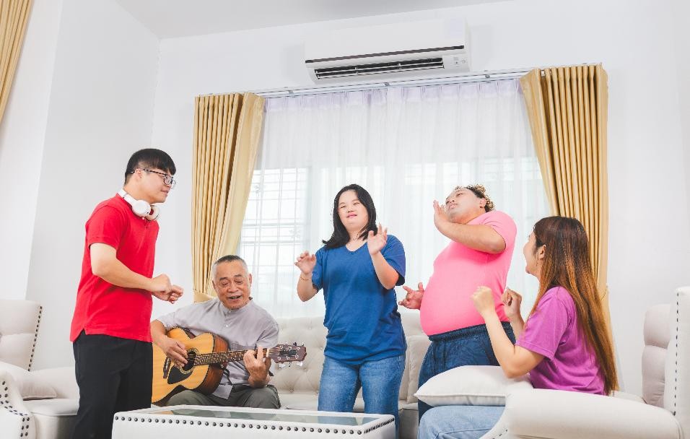
What groups do we belong to?
Unit E4
Who belongs in my family
and community?
Presentation 3

Slide 5
Pathway 4: Personal Journey
Early Years
Through exploring what is meant by a Personal Journey, children will learn that:
People in their family and community may have had important or life-changing experiences and encounters.
Some people have amazing, puzzling or mysterious experiences that make them ask big questions about life.
How this presentation links to the pathway:
In this presentation, children think about how they belong to different groups in our community. These might be school, sports, creative or religious groups. They explore how they can be part of different groups and how belonging to a group makes them feel.

Slide 6
Learning objectives
Talk about the groups they belong to such as a family, class, school or team
Explore faith groups that they and others belong to

Slide 7
Key words
belong
feel like we're in the right place
in common
something people do or have
that is the same

Slide 8
Recap: Families
Think of a person for each part of the triangle.
me
people I know
people I don't know
family
friends
Notes:
Use this slide from the previous session to develop understanding of community. Remind children that the number of people in each group increases as we go down the triangle. Recap how we should show kindness to people in each section.

Slide 9
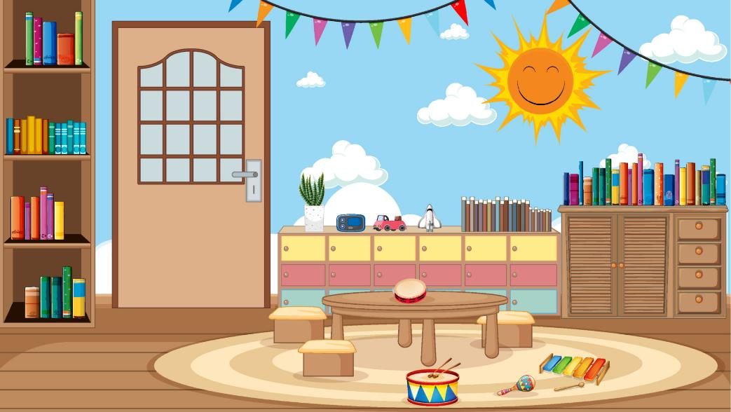
Introduction: Who belongs here?
Let's go on a belonging hunt inside our school!
What clues will we find?
Notes:
Ideally, replace this picture with one of your school, or go on to your school's website. Take the children for a walk around the inside of the school building. Look at the other classes and areas of school. What symbols and objects show that the school belongs to us? Look at images, logos and special objects. Who “lives” in this class? Which teacher is in this room? What is this room used for? How can we tell? What does the head teacher do? Take photographs of the 'belonging' clues you find.

Slide 10
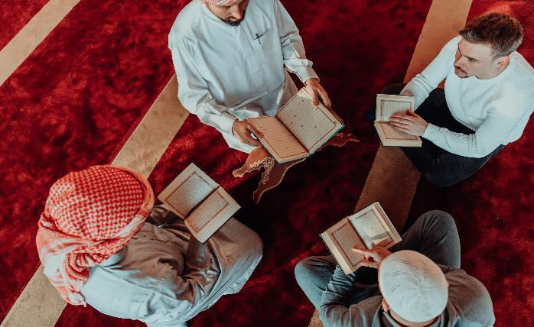
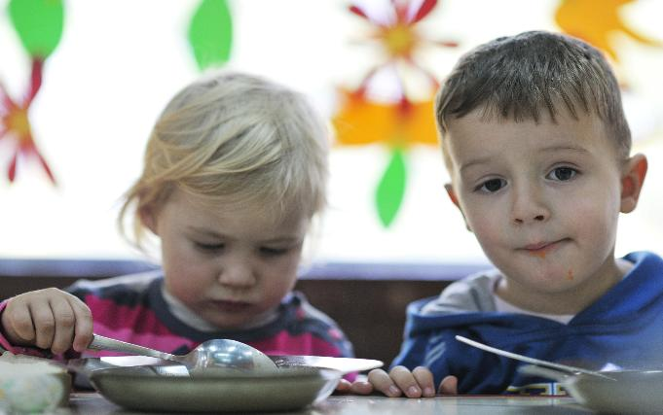
Discussion: Belonging to a group
How are these groups different?
How are they the same?
Notes:
Accept all contributions to the discussion and encourage children to explain their answers.

Slide 11
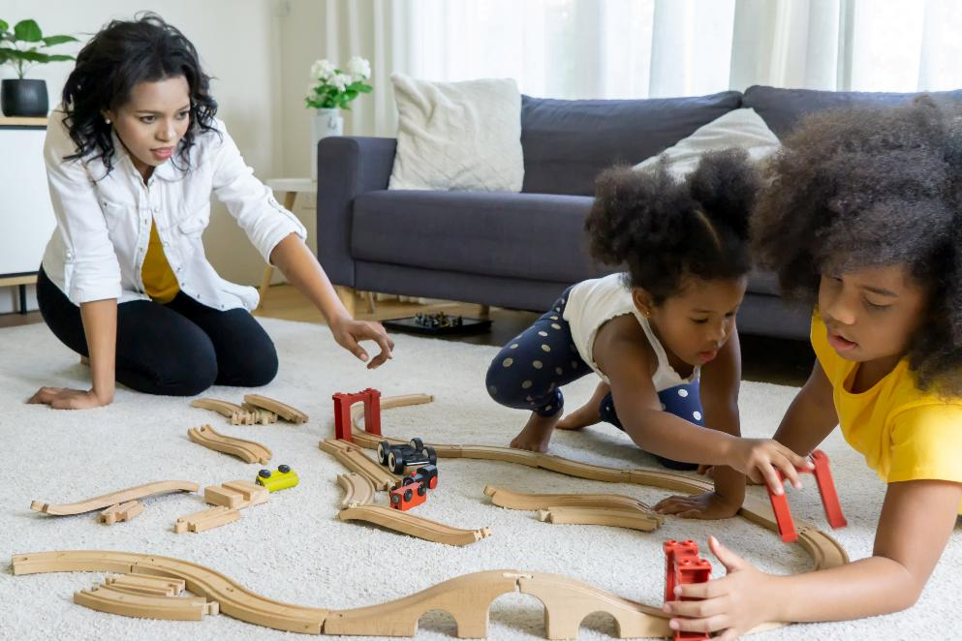
Explanation: Belonging to a group
We can all belong to different groups.
You are already a part of a special group- your family!

Slide 12
Explanation: Belonging to a group
We can belong to a group at school. We are in ______ class!
We can learn in a group.
We can go to a club at school like breakfast club or after school club.

Slide 13
Explanation: Belonging to a group
Some people belong to a creative group like music, singing, dancing or crafts.

Slide 14
Explanation: Belonging to a group
Some people belong to a sports club like swimming, football, rugby or cricket.

Slide 15
Explanation: Belonging to a group
Some people belong to a religious group like a prayer group.
These Muslim men are reading the Qu’ran together at a Mosque.

Slide 16
Explanation: Belonging to a group
People might belong to more than one group.

Slide 17
Discussion: Which groups do you belong to?
Think – pair – share;
Which groups do you belong to?
How do you show you belong to each group?
Notes:
Talk about other groups children might belong to, including religious communities. Invite parents to send in any information about groups their children are a part of in the wider community e.g. church, mosque, religious groups, dance or music groups, sports clubs, after school club etc. Talk about these groups in class and explain that children can belong to more than one group. How do we show we belong to these groups? Talk about special clothes, badges, actions. NB include children not in outside clubs by focusing on school clubs, school-based awards and certificates.

Slide 18
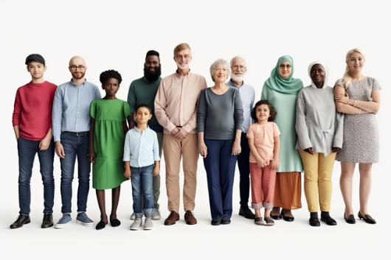
Explanation: Getting together
Belonging to a group means that people can spend time together enjoying the things they have in common. We get a warm feeling of belonging when we are in a group of people who care about us.
Notes:
The BBC bitesize video Why is it nice to belong to something? - BBC Bitesize has a short explanation of belonging, using a Christian example of belonging to a faith group.

Slide 19
Suggested tasks: Adult-led
Invite staff members to come and talk to children about their role in school e.g. the head teacher, the caretaker, office manager, a teacher from another year group. ‘Hot Seat’ a special person in school. Question them about their role in school.
Make a community wall–pictures of people in the school and local community and write why they are important to us e.g lollipop person, local PC, local shop etc.
Share a book from the ‘Belonging and Believing’ series of books, especially written for Early Years. It introduces children and families from a range of religions/worldviews.
Notes:
Select activities from the list

Slide 20
Suggested tasks: Independent in provision
Ask children to draw themselves and draw the different groups they belong to e.g. Rainbows, Cubs, Beavers, family, Church, Mosque, temple.
Make a display showing all the groups we belong to.
Design and make a badge to wear.
Role play people in our community using a selection of special clothes/uniforms.
Notes:
Select activities from the list

Slide 21
Learning summary
We all belong to groups in our community, including our family. We belong to our class and groups in school.
We might belong to sports teams, creative groups or religious groups. Groups might have special signs or uniforms.
People in a group are together enjoying something they have in common. We can have a feeling of belonging when we are in our group.

Slide 22
Conclusion: Groups we belong to
School
Faith groups
Groups we belong to
Sports
Creative
Notes:
Collect together the different groups that children in the class belong to. This can be through pictures made in provision or by making a list in each box. Invite children who are confident to describe what it is like in a group they are in to the others. Try to include a child who can describe their faith group if you have them. If the variety of faith/beliefs in the class is very limited, persona dolls, film clips or staff members may be used to introduce additional faiths/beliefs, as appropriate.

Slide 23
Time to think
Think of a group that you belong to.
How does it feel being in your group?
We all have the power to help others feel like they belong in our group.
How would you welcome someone new?

Slide 24
Acknowledgements
Images reproduced under professional licence from Vecteezy.

